Slide 1
Containerizing .NET Petshop
A Modernizing Traditional Applications walkthrough

Slide 2
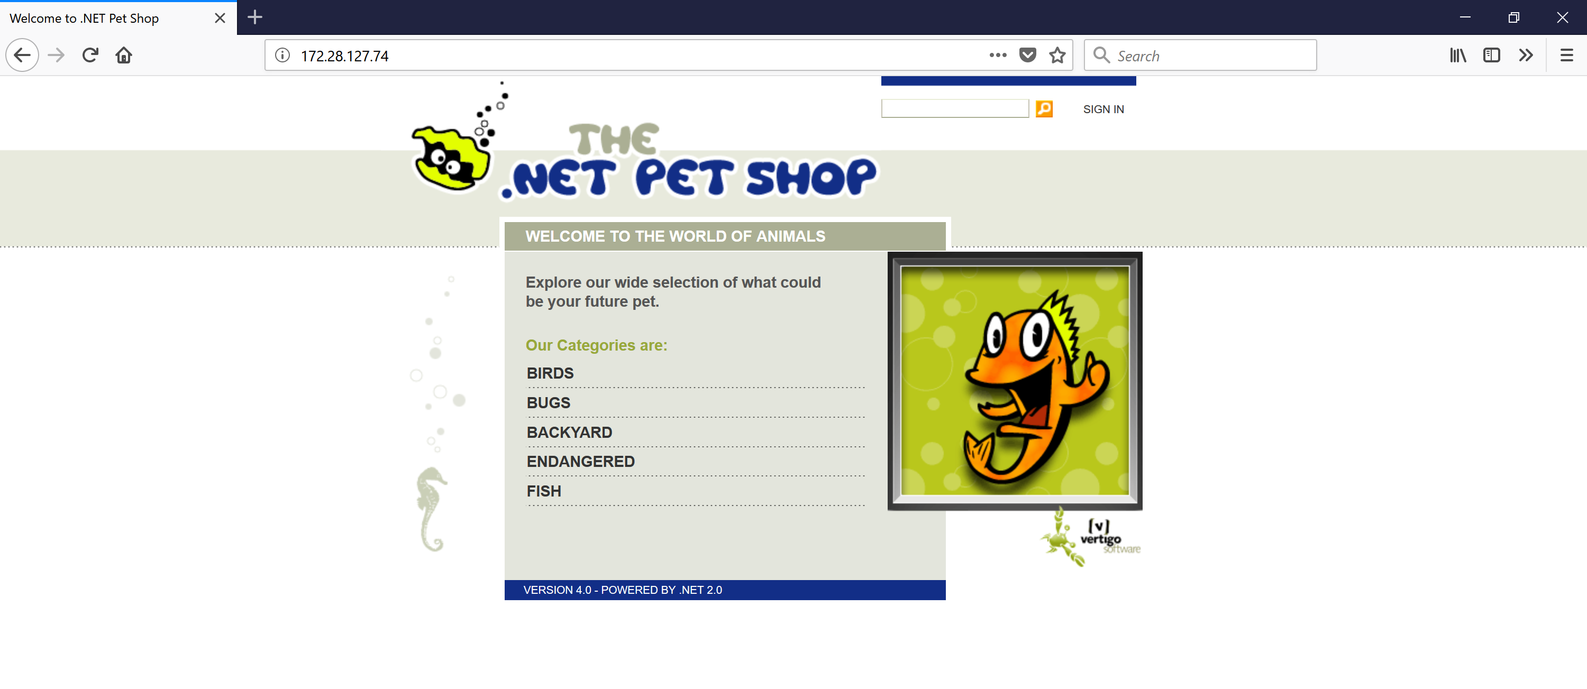
Summary: .NET Petshop in containers

Slide 3
Introduction
MTA brings portability, agility and security to existing apps
Demo apps are often too simple compared to real life apps
Petshop is an actual traditional application from 2006
Modernizing traditional applications process made concrete
Notes:
Disclaimer: The .NET Pet Shop was always meant to be a sample application, so a containerized version is still that. It is

Slide 4
Challenge 1: Just an old MSI
The app was not running, but there is an old MSI installer file
Get a Windows Server 2016 VM in Azure
The app requires a SQL Server database and ASP.NET 2.0
Install SQL Server (Later: SQL on Windows base image)
Install IIS and ASP.NET 3.5 (Later: ASP.NET 3.5 Windows base image)

Slide 5
Challenge 2: MSI just deploys source code
The installer just deploys source code
Install Visual Studio
Open, build and run the solution
Configure IIS to host the web app (app pool, website, folder)

Slide 6
Challenge 3: Start containerization
From the running application determine the containerization process
Start with the original installer? (Too complex)
Start with Image2docker?
TBD
Start with copying assets?
Copy website folder
Copy SQL data & log files

Slide 7
Challenge 4: Persistent data with SQL Server database
Determine persistence approach
Keep data persisted outside container
Use plain SQL on Windows base image
Create a volume with data & log files
Attach database upon instantiation
Store initial data inside container and allow reset
Use specialized image based on SQL on Windows
Copy data & log files

Slide 8
Diagram?

Slide 9
References
Github.com/pdebruin/petshop
Hub.docker.com/r/pdebruin/petshop?

Slide 10
pieterd@docker.com

